Slide 1

ONLINE QUIZ SYSTEM WITH RESULT TRACKING
SAAD YUSUF KHAN
150096725157
ITM SKILLS UNIVERSITY
SCHOOL OF FUTURE TECH

Slide 2

Problem Statement
Goal: To build an automated, interactive, console-based quiz system that validates input, tracks per-question results, and displays a detailed result summary.
The Challenge: Traditional paper-based quizzes and basic digital quiz systems have key limitations:
No instant feedback on individual question performance
Users only see a final score with no breakdown of right or wrong answers
No input validation — invalid entries can crash or disrupt the program
No way to review score after the quiz without restarting
Manual evaluation is time-consuming and error-prone

Slide 3
Our Solution — Online Quiz System
What we built: A menu-driven C++ console application that solves all the above problems.
Technology Used: C++ | cin / cout | Global Arrays | Functions | Switch-Case | Loops
Presents 3 multiple-choice questions with 4 options each
Validates every input — rejects anything outside 1 to 4
Stores each question result as "Correct" or "Wrong" using a string array
Displays a full per-question result summary after quiz completion
Allows users to review their last score anytime from the main menu
Clean modular design using separate functions for each task

Slide 4
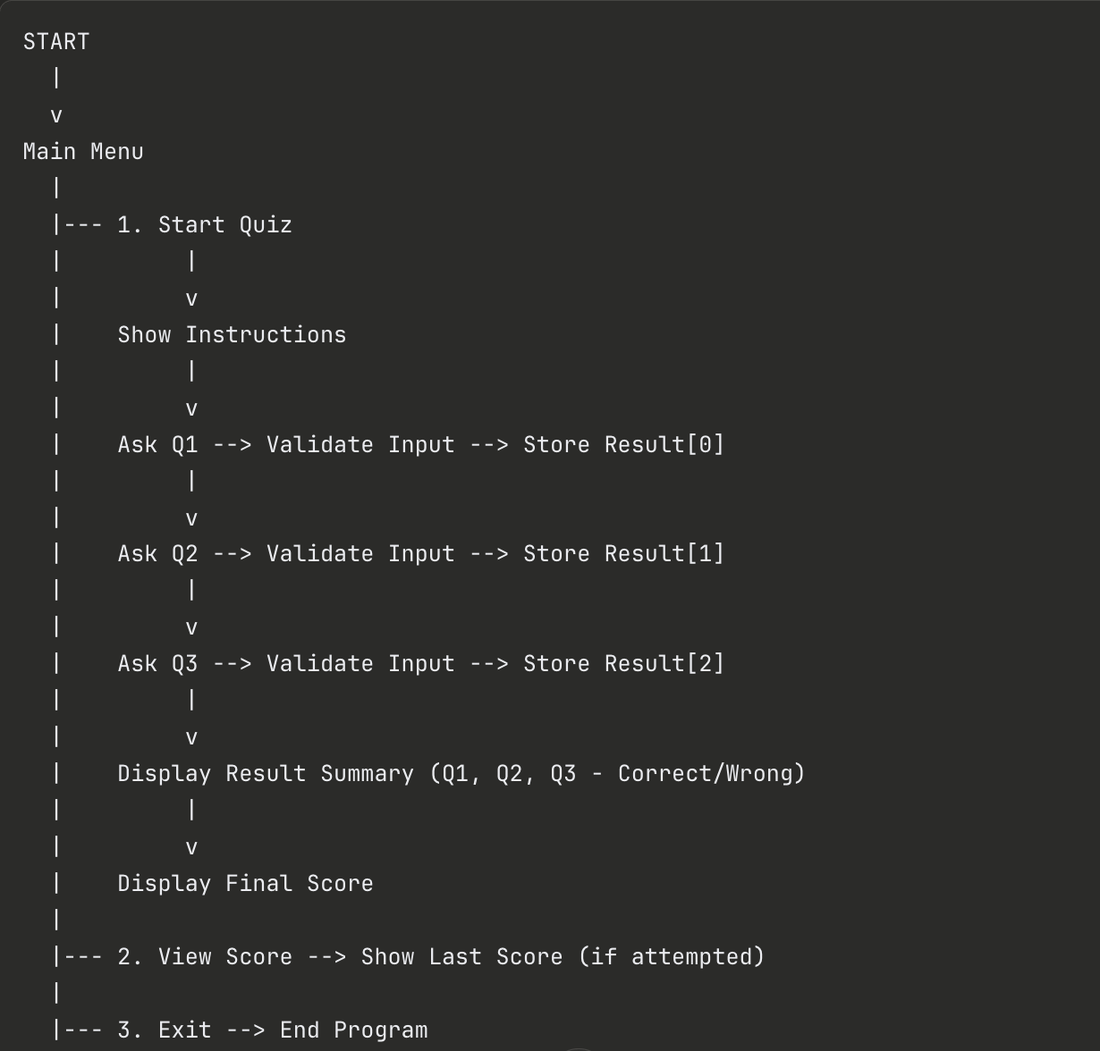
How It Works
Program Flow:
Key Components:
FunctionPurposeshowInstructions()Displays quiz rulesaskQuestion()Delivers question, validates input, stores resultstartQuiz()Manages full quiz flow and result summarymain()Menu loop with switch-case routing
Data Used:
score (int) — tracks total correct answers
quizAttempted (bool) — tracks if quiz was taken
results[3] (string array) — stores Correct/Wrong per question

Slide 5
Conclusion
What this project demonstrates:
How to build a fully functional menu-driven application in C++
Practical use of global variables, arrays, functions, and loops together
Importance of input validation in making programs robust and crash-proof
How arrays can be used to store and display per-question result tracking
Clean modular code design using separate functions for each responsibility
What can be added next:
File handling to save scores permanently across sessions
Larger randomized question bank
OOP redesign using classes and objects
Timer feature for each question
Difficulty levels (Easy / Medium / Hard)
Key Takeaway: Even a simple C++ console program can be structured, validated, and feature-rich when built with clean logic and modular design.

Slide 6
THANK YOU
SAAD YUSUF KHAN
150096725157

